Slide 1


Chat Application
By Alec Gestenslager

Slide 2
Motivation
I chose this program because I have always been curious about how programs like iMessage or What’sApp send messages between two users. This is not on the same scale as those applications, but it does break the surface of how those applications work.
Others could use this project to create a home instant message (IM) network between household members or an IM network local to an office.

Slide 3
What does it do?
This program utilizes sockets and server sockets to send messages between two clients on one network and displays the text to the screen like a chat room. Some examples of similar programs are What’sApp, Discord, iMessages, and other message and chat applications.

Slide 4
Classes
This program, as of 15 April, has 5 classes that show inheritance and the basis of a graphical user interface. In the end, this project will have a fully working GUI that can send and receive text messages and display those messages on the screen as they are received. It will have a Socket and ServerSocket connection that can connect to each other and send and receive messages.

Slide 5
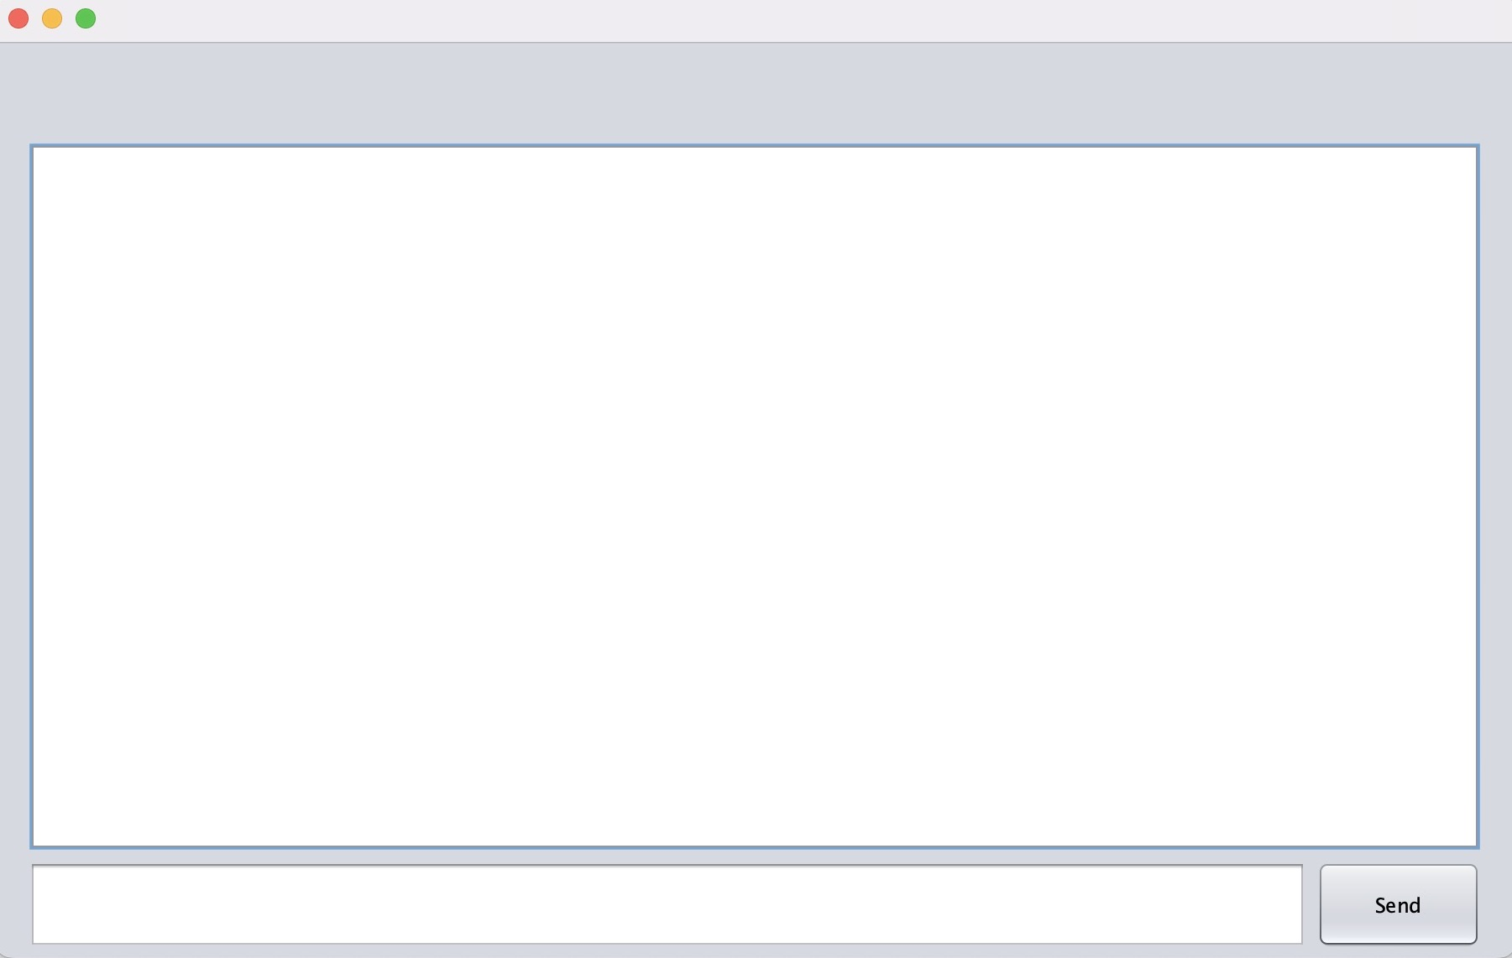
Examples
On the right is an example of what the GUI looks like now. The empty white space that takes up most of the screen is where the text will be displayed. The white bar at the bottom of the screen is where the text to be sent will be typed. The button in the bottom right corner of the screen will be used to send the text in the text field to its left.

Slide 6
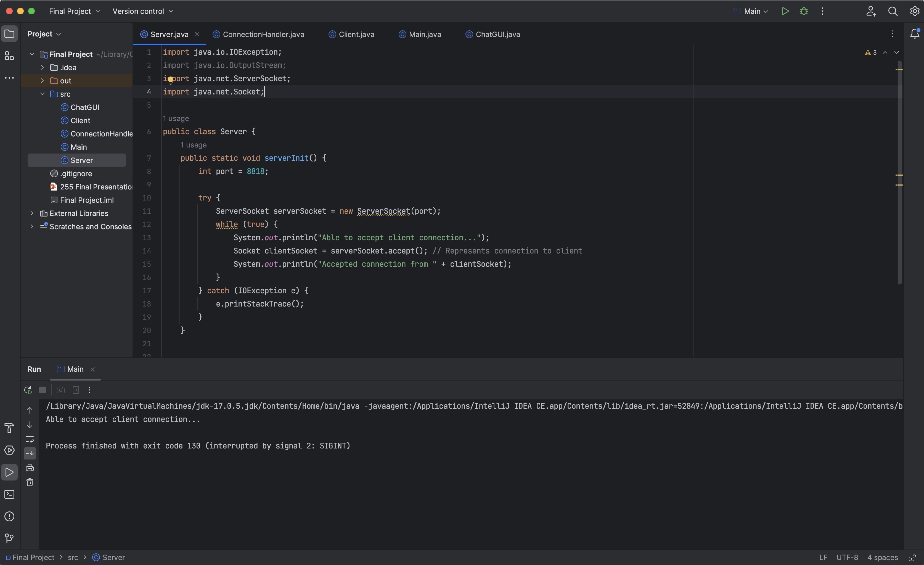
Examples
To the right is an example of the ServerSocket code. This, along with the Socket code, will run the communication between the two chat windows.

Slide 7
Outcome
While the project is still in progress, so far, the project has a working GUI and Socket and Server Socker connection, but cannot send and receive messages using the GUI, as intended to. It also cannot display text to the GUI text windows. At the end of this project, the program will be a fully functioning messaging application, where users can send and receive messages from those that they are connected to.

